Slide 1
GTWORLD BANK
PRESENTED BY:
*NWOLISA DANIEL
*ADEYEMI JOEL
*PEACE JOHN
*EGBUSON EMMANUEL
*JOHN GOODNESS

Slide 2
INTRODUCTION
Welcome to the presentation.
Today, we'll be introducing you to Gtworld Bank, a cutting-edge banking app built with Python.
Gtworld Bank aims to address the challenges faced by traditional banking methods and provide users with a modern, efficient, and secure banking experience.

Slide 3
Traditional banking methods are often cumbersome, time-consuming, and lack flexibility.
Customers demand more convenient and user-friendly banking solutions.
GTworldBank is our answer to these challenges, offering a seamless and intuitive banking experience.

Slide 4
FEATURES
Account Management: Easily view account balances, transaction history, and manage accounts.
Money Transfers: Transfer funds between accounts or to other users quickly and securely.
Bill Payments: Pay bills, set up recurring payments, and track payment history.
Budget Tracking: Monitor spending habits, set budgets, and receive alerts for overspending.
Security Measures: Advanced encryption, biometric authentication, and real-time fraud monitoring ensure the highest level of security for users.

Slide 5
Gtworld Bank is powered by Python, a versatile and powerful programming language.
We leverage Flask, a lightweight web framework, for building the backend of our app.
Database management is handled using SQLite for efficient data storage and retrieval.

Slide 6
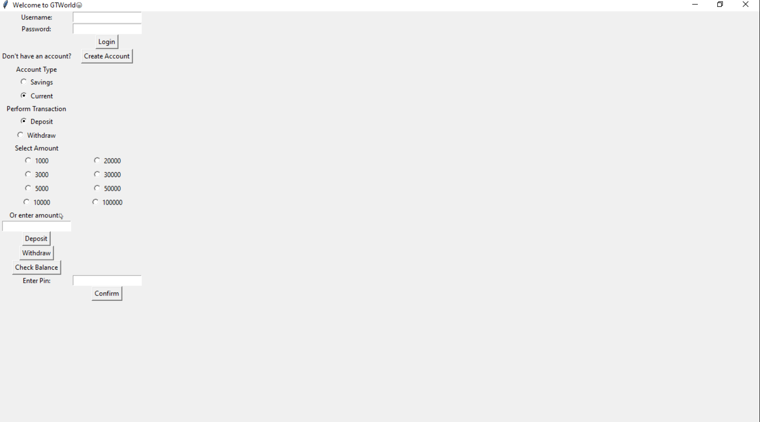
USER INTERFACE
The Gtworld Bank app features a sleek and user-friendly interface designed for easy navigation.
Intuitive menus, clear visuals, and responsive design provide a seamless user experience.
Let's take a look at a screenshot of the Gtworld Bank app in action:

Slide 7
Security measures
Security is our top priority at Gtworld Bank
Our app employs state-of-the-art encryption protocols to protect user data.
A password is required to login and perform any transaction.
Real-time fraud monitoring detects and prevents unauthorized transactions, giving users peace of mind.

Slide 8
Flow chart
START
Account Exists?
NO
Create an Account
YES
Login An Account
View an account
Deposit Money
Check Account Balance
Withdraw Money
END

Slide 9
BENEFITS FOR CUSTOMERS
Convenience: Access banking services anytime, anywhere, from your mobile device.
Security: Robust security measures ensure the safety of your financial information.
Personalization: Receive tailored recommendations and insights based on your financial habits.

Slide 10
CONCLUSION
Thank you for joining us today to learn more about Gtworld Bank.
We're excited to bring you a modern, secure, and user-friendly banking experience.
If you have any questions or would like to learn more, please don't hesitate to reach out.

Slide 11
Contact information
EMAIL : info@gtworldbank.com
PHONE : 09027085504
FOLLOW US ON SOCIAL MEDIA : @GTWORLD_BANK

Slide 12
THANK YOU

